Slide 1
Module 5

Slide 2
Corporate governance is the combination of rules, processes and laws by which businesses are operated, regulated and controlled.
The term encompasses the internal and external factors that affect the interests of a company's stakeholders, including shareholders, customers, suppliers, government regulators and management.

Slide 3
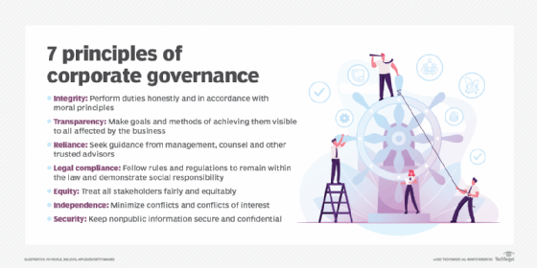

Slide 4
IT governance is an element of corporate governance, aimed at improving the overall management of IT and deriving improved value from investment in information and technology.
IT governance frameworks enable organisations to manage their IT risks effectively and ensure that the activities associated with information and technology are aligned with their overall business objectives.

Slide 5
IT governance enables an organisation to:
Demonstrate measurable results against broader business strategies and goals.
Meet relevant legal and regulatory obligations, such as those set out in the GDPR (General Data Protection Regulation) or the Companies Act 2006.
Assure stakeholders they can have confidence in your organisation's IT services.
Facilitate an increase in the return on IT investment; and
Comply with certain corporate governance or public listing rules or requirements.

Slide 6
The five domains of IT governance
The IT Governance Institute (a division of ISACA) breaks down IT governance into five domains:
Value delivery
Strategic alignment
Performance management
Resource management
Risk management

Slide 7
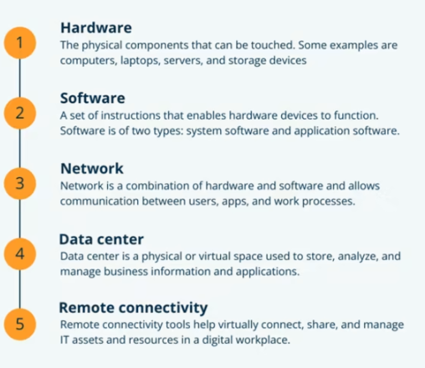
IT Governance Framework

Slide 8
Fault tolerance
Fault tolerance is a process that enables an operating system to respond to a failure in hardware or software.
This fault-tolerance definition refers to the system’s ability to continue operating despite failures or malfunctions.
An operating system that offers a solid definition for faults cannot be disrupted by a single point of failure.
It ensures business continuity and the high availability of crucial applications and systems regardless of any failures.

Slide 9
Normal Functioning
This describes a situation when a fault-tolerant system encounters a fault but continues to function as usual.
This means the system sees no change in performance metrics like throughput or response time.

Slide 10
Graceful Degradation
Other types of fault-tolerant systems will go through graceful degradation of performance when certain faults occur.
That means the impact the fault has on the system’s performance is proportionate to the fault severity.
In other words, a small fault will only have a small impact on the system’s performance rather than causing the entire system to fail or have major performance issues.

Slide 11
Components of a Fault-tolerance System
Diversity
If a system’s main electricity supply fails, potentially due to a storm that causes a power outage or affects a power station, it will not be possible to access alternative electricity sources.
In this event, fault tolerance can be sourced through diversity, which provides electricity from sources like backup generators that take over when a main power failure occurs

Slide 12
Redundancy
Fault-tolerant systems use redundancy to remove the single point of failure.
The system is equipped with one or more power supply units (PSUs), which do not need to power the system when the primary PSU functions as normal.
In the event the primary PSU fails or suffers a fault, it can be removed from service and replaced by a redundant PSU, which takes over system function and performance.

Slide 13
Replication
Replication is a more complex approach to achieving fault tolerance. It involves using multiple identical versions of systems and subsystems and ensuring their functions always provide identical results.

Slide 14
Elements of Fault-tolerant Systems
Hardware Systems
Hardware systems can be backed up by systems that are identical or equivalent to them.
A typical example is a server made fault-tolerant by deploying an identical server that runs in parallel to it and mirrors all its operations, such as the redundant array of inexpensive disks (RAID), which combines physical disk components to achieve redundancy and improved performance.

Slide 15
Software Systems
Software systems can be made fault-tolerant by backing them up with other software.
A common example is backing up a database that contains customer data to ensure it can continuously replicate onto another machine.
As a result, in the event that a primary database fails, normal operations will continue because they are automatically replicated and redirected onto the backup database.

Slide 16
Power Sources
Power sources can also be made fault-tolerant by using alternative sources to support them.
One approach is to run devices on an uninterruptible power supply (UPS). Another is to use backup power generators that ensure storage and hardware, heating, ventilation, and air conditioning (HVAC) continue to operate as normal if the primary power source fails.

Slide 17
High Availability
the term availability is used to describe the period of time when a service is available, as well as the time required by a system to respond to a request made by a user.
High availability is a quality of a system or component that assures a high level of operational performance for a given period of time.

Slide 18
Measuring Availability
Availability is often expressed as a percentage indicating how much uptime is expected from a particular system or component in a given period of time, where a value of 100% would indicate that the system never fails.
For instance, a system that guarantees 99% of availability in a period of one year can have up to 3.65 days of downtime (1%).

Slide 19
An IT governance framework typically provides reference models for:
IT processes
Input and output of processes
Key process objectives
Performance measurement techniques

Slide 20
COBIT: This is by far the most popular framework out there. It gives staff a reference of 37 IT processes, with each process defined with process inputs and outputs, objectives, methods to measure performance and more.
ITIL: Stands for Information Technology Infrastructure Library, this framework includes five management best practices from strategy to design that aims to ensure that IT supports core business operations.
COSO: From the Committee of Sponsoring Organizations of the Treadway Commission, this framework focuses on more general and less IT-focused processes, with an emphasis on enterprise risk management and fraud deterrence.
CMMI: Also known as the Capability Maturity Model Integration framework, this process uses a scale of 1 to 5 to better understand how the organization is performing and maturing over time.
FAIR: Also known as the Factor Analysis of Information Risk, this framework has an emphasis on cyber security and risk assessment, with the ultimate goal of making better-informed decisions.

Slide 21
DISASTER RECOVERY
Disaster recovery are the processes, policies and procedures associated with preparing for recovery or for continuation of technology infrastructure significant to an organization subsequent to either a natural or human-induced disaster.

Slide 22
A disaster recovery plan (DRP) which is also sometimes referred to as business continuity plan (BCP) or as business process contingency plan (BPCP) basically describes how an organization has to deal with potential disasters that may affect it.
Just as a disaster is an incident that makes the continuation of normal functions and business process impossible, a disaster recovery plan includes all the precautions that must be considered so that the effects of a disaster is minimal on the business process

Slide 23
A business continuity plan (BCP) involves planning for non-IT associated aspects, for instance, key human resources, facilities, emergency communication and reputation protection, and must refer to the disaster recovery plan (DRP) for IT associated infrastructure recovery or continuity.

Slide 24
Testing Recovery Plan
Making the plan is different from testing it in real environment, so as to verify it will work fine if the organization is hit by a disaster. Therefore, it is essential to check the disaster recovery plan made by the organization.

Slide 25
The disaster recovery plan can be tested and verified by various methods. Some of them are as follows:
Walk-through
It is the simplest method to test a particular plan. Members of team, who have been part of preparing it, check all the steps of the plan to discover all or some inconsistencies.
If they find any inconsistencies
they should report it and change it accordingly.

Slide 26
Simulation
The other method of testing the recovery plan is by creating a simulated environment.
The simulation means creating a situation that will resemble a disaster as closely as possible.
Full Interruption
This type of testing is just opposite to parallel testing. In this testing, operations are closed to check the plans and backups.

Slide 27
Checklist
Another method to test the plan is by checking it against an ordered checklist.
Members of different departments/teams check the tasks for which they are responsible and put a tick against the action performed in the checklist.
Parallel Testing
This type of testing is most unusual.
In this testing, the plan is tested when the full services are on, that is, the backup testing occurs in tandem with production services which never stops.

Slide 28
Steps to Developing an Effective Disaster-recovery Process
Acquire Executive Support:
Select a Process Owner
Assemble a Cross-Functional Team:
Conduct a Business Impact Analysis
Identify and Prioritize Requirements:
Evaluate Possible Business-Continuity Strategies:
Choose Participants and Clarify Their Roles for the Recovery Team
Document the Disaster-Recovery Plan
Plan and Execute Frequent Scheduled Test of the Recovery Plan:
Conduct Lessons-Learned Postmortem after Each Test

Slide 29
STORAGE MANAGEMENT
Storage management signifies computer data storage. In computer terminology, storage can be defined as an electronic place which can store instructions and data, from where the computer’s microprocessor can quickly and easily access them.
The objective of storage management is to characterize, maintain and track data and data resources in the organization, so that data can be stored efficiently.
The primary role of storage management is to ensure proper operation and maintenance of storage media..

Slide 30
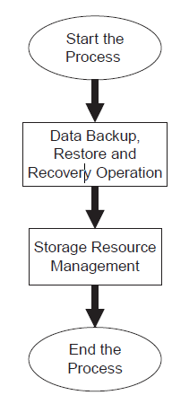
Storage Management Process

Slide 31
Initiate the Process
The storage management first of all initiates the process of storing the data according to its importance and accessing frequency.
After that, it ensures that a backup is periodically taken of the stored data, so that it can restore the data at the time of requirement

Slide 32
Data Backup, Restore and Recovery Operation
The storage administrator ensures that the backup and archives are taken periodically for restoration purpose.
The process of taking backup can be either manual or automatic, depending upon the requirement.

Slide 33
Storage Resource Management
Once the backups and archives are taken, the next step is to manage the data repository in which all of these are stored.
The important data are placed in online memory where as the backups and archives are stored in the offline memory at a safe place, with proper security mechanism.

Slide 34
End the Process
The last step is ending the process, which in reality never ends.
The process is in continuation in the organization all the time.

Slide 35
Benefits of Storage Management
The storage management presents various advantages to the organization. Some of the potential benefits of storage management are as follows:
􀂄 Reduced operational costs of storing the data.
􀂄 Consistent service levels.
􀂄 Enhanced customer satisfaction with quick restoration of data.
􀂄 Better arrangement of IT processes with business processes.
􀂄 More proficient utilization of resources, including man power.

Slide 36
Security Management
The main objective of security management is to prevent unauthorized access of data by inside and outside forces of the organization.
With the development of the Internet, the responsibility of security management in an organization has increased a great deal

Slide 37
GOALS OF SECURITY MANAGEMENT
Security management fundamentally comprises of five different goals. These goals ensure that the security of data and information along with system and their resources are maintained in the organization.
The different goals are as follows:

Slide 38
Integrity: Integrity is a method of making sure that the information has not been altered or modified by any unauthorized or unknown means. It ensures that the information cannot be modified.
􀂄 Confidentiality: Confidentiality makes sure that the information is protected from unauthorized users. It can be defined as an act of keeping something confidential and secret from everyone but apart from those who are authorized to use it.
􀂄 Availability: Availability makes sure that the resources are made available to the authorized users whenever they demand it.
Non-repudiation: Non-repudiation makes sure that the authorized user’s demand of resources is not denied by the system.
Authentication: Authentication makes sure that only the authorized users have the right to access the resources of the system. It is also used to establish honesty by corroborating the identity of a user.

Slide 39
WWW AND SECURITY
The lack of security on the Internet is the one of the major concerns for nearly all e-commerce applications.
Various commercial applications insist that the client–server should authenticate each other and there should be transfer of message between client–server and application confidentially.
This message exchange has basically the following three basic properties:
(i) Server authentication: Clients are confident regarding various e-commerce application servers.
(ii) Privacy: Using cryptography technique so that communication is made secure and private.
(iii) Integrity: Clients’ conversations are not modifie

Slide 40
Client–Server Security Problems
Physical security holes: Unauthorized individual gaining access to the network by utilizing the physical security holes present in the network.
Software security holes: Software doing the work which they are not intended for, such software are categorized as malicious software.
Inconsistent usage holes: Collection of ineffective hardware and software that causes flaws to the security of the network which an intruder or unauthorized user can take advantage of.

Slide 41
Protection Methods
Trust-Based Security
Trust-based security means that the employer trusts his employees and does not deploy any hardware or software for security in the organization

Slide 42
Security Through Obscurity
Security through obscurity signifies that the organization protects its data and data resources from outsiders and provides information to its users on a requirement basis.

Slide 43
Password Schemes
To secure the client–server network, the universal approach deployed by organizations is the password schemes.
In this particular scheme, different users are provided different password with different privilege according to their requirement

Slide 44
Biometric Schemes
Biometric schemes are the most advanced techniques providing highest level of security to the network and are currently being deployed by the organization

Slide 45
Firewall
A firewall is a component of the computer system or network that is intended to block unauthorized access while permitting the flow of authorized communications.
A firewall’s fundamental task is to control the flow of traffic between computer networks.
It either denies or permits passage of flow of packets based on certain rules which vary from organization to organization depending upon the policy.

Slide 46
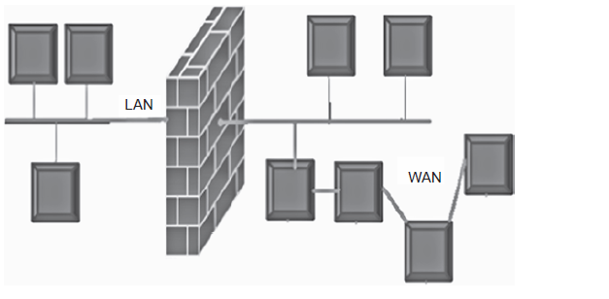

Slide 47
Types of Firewalls
Conceptually, there are three types of firewalls:
(i) Network layer
(ii) Application layer
(iii) Hybrids

Slide 48
IT Ethics
The availability of the computer to a large part of the common society has brought a number of individuals under its influence, who might not be well-disciplined ethically.
With the rapid development in the IT field, the knowledge of ethics has become important.
As everything is easily available to everybody, the breaching of ethics has become common.
People do not hesitate in taking advantage of other people’s work either knowingly or unknowingly.
People who use the Internet for their work, break the law somewhere. So, it is necessary to have the knowledge of ethics in the field of IT

Slide 49
INTRODUCTION TO CYBER ETHICS
The expression ‘cyber ethics’ indicates a code of safe and responsible actions for the Internet community.
Good cyber ethics comprises of understanding the threats of harmful and illegal behaviour online and finding out how to defend oneself and other Internet users from such behaviour.
It also includes teaching young people, who do not identify the possible harm of Internet safety and teaching them how to use the Internet safely and responsibly.
Therefore, we can divide learning cyber ethics into numerous categories,
which are described below

Slide 50
INTELLECTUAL PROPERTY
The term intellectual property (IP) reflects the thought that the subject material is the artefact of the mind or the intellect.

Slide 51
Financial Incentive
The restricted use of IP permits their owners to achieve profit from the property they have produced, providing financial incentive for making those properties and investing in them.

Slide 52
Economic Growth
The existence of IP laws are credited with important contributions to economic growth.
Economists approximate that two-thirds of the cost of large organizations in the United States could be traced to intangible assets.

Slide 53
Types of Intellectual Property
Copyrights
A copyright is an exclusive rights granted on the proprietor of a literary or imaginative work worthy of publication, allotment and adaptation of imaginative works.
Copyrights cover matters like literary works, compositions, computer software, plays or theatre works, and movies.
But copyright do not cover the thoughts articulated in such works

Slide 54
Trademarks
Trademarks are the characteristic distinguishing signs, symbols, or indicators used by an individual or an organization, which are normally used to recognize a particular artefact or services which specifies its source to differentiate its artefacts or services from those of other individual or organization.
Patents
Patents are a set of special rights approved by a state to an inventor for a certain time period for the public display of his invention.
Patents are rights which are normally associated to new inventions.

Slide 55
collaboration tool
A collaboration tool helps people to collaborate.
The purpose of a collaboration tool is to support a group of two or more individuals to accomplish a common goal or objective.
Collaboration tools help to eliminate gate-keeping by offering direct access to ideas, projects, and feedback from others in an instant.
If your team adopts the right tools and uses them properly, they can help tackle many of today’s top challenges: productivity, engagement, and connection.

Slide 56
Improved productivity:
Streamlined communication:
Improves team relationships:
Easier to work remotely:

Slide 57
4 main types of collaboration tools for business
1. COMMUNICATION AND MESSAGING TOOLS
2. VIDEO CONFERENCING TOOLS
3. TASK AND PROJECT MANAGEMENT TOOLS
4. CLOUD STORAGE AND FILE SHARING TOOLS

Slide 58
online collaboration tools for business
SLACK
GOOGLE DRIVE
HIVE
ANIMOTO
ZOOM

Slide 59
E-business
E-business (electronic business) is the conduct of online business processes on the web, internet, extranet or a combination thereof.
These customer-, internal- and management-focused business processes include buying and selling goods and services, servicing customers, processing payments, managing production and supply chains, collaborating with business partners, sharing information, running automated employee services and recruiting employees.

Slide 60
E-business is similar to e-commerce but encompasses much more than online purchasing transactions.
Functions and services range from the development of intranets and extranets to the provision of e-services over the internet by application service providers.
Enterprises conduct e-business to buy parts and supplies from other companies, collaborate on sales promotions and conduct joint research

Slide 61
IBM was one of the first companies to use the term e-business in October 1997, when it launched a thematic campaign to address the confusion many consumers had about internet-based businesses.

Slide 62
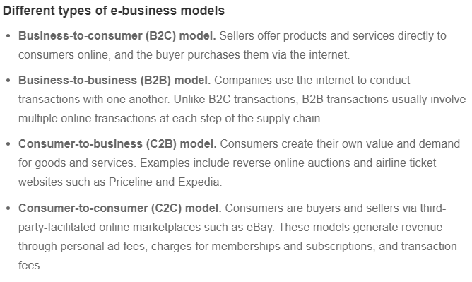

Slide 63
COBIT and Val IT
The COBIT and “value from IT investments” (Val IT) are frameworks developed by the Information Systems Audit and Control Association (ISACA) and the IT Governance Institute designed to help business executives, IT personnel and management staff to properly manage and govern their IT systems and IT-enabled investments.
Each framework targets specific objectives and controls inside the business and how IT should align to these controls.

Slide 64
COBIT focuses on managing the development and implementation of IT systems while monitoring for risks.
Val IT is based on COBIT as it focuses on helping businesses understand their needs so they can seek out the right IT-enabled investments that will offer the best value.
The purpose of COBIT is to provide the guidelines and best practices that businesses can use to gain the greatest value from their information technology systems and processes.

Slide 65
Purpose of Val IT
Val IT is another framework of IT governance to help businesses decide on the right investments to make in IT-enabled systems.
It provides a management technique for businesses that are thinking of changing their systems so they can bring in more value for their investment decisions

Slide 66
RISK IT
COBIT 5 for Risk, allows an organisation to improve IT risk related capabilities, awareness, communication, decision making, outcomes and directing strategy by enabling the following:
Providing key stakeholders a consistent, accurate and validated assessment of the current level of IT risk and impact to the organisation.
Managing risk in line with the approved IT risk appetite.
Implementing the correct IT risk culture.
Quantitative approach to assessing IT risk mitigation costs versus loss exposure.
Advocating risk responsibility and acceptance.

